Slide 1
Module 6
Navigation & Routing

Slide 2
Button Widget
A button can have an icon or a Text(or both).
When the user touches on it, It will trigger the click event and get the appropriate action.
Flutter has various types of buttons. These button types utilized for different purposes.
Please note
  A button has consisted of a text or an icon
  We can design a button using different shapes, colours, animations and behaviours.
  Button also can contain it’s child widgets for different usages.

Slide 3
What are the Button Types in Flutter?
Material Button
Elevated Button
Floating Button
Drop Down Button
Icon Button
PopupMenu Button

Slide 4
Flat Button
This is the most common button. It has consisted of a simple text.
There have two reqquired properties, child and onPressed().
Optionallly you can decorate it using its attributes(colour, text size etc.).

Slide 5
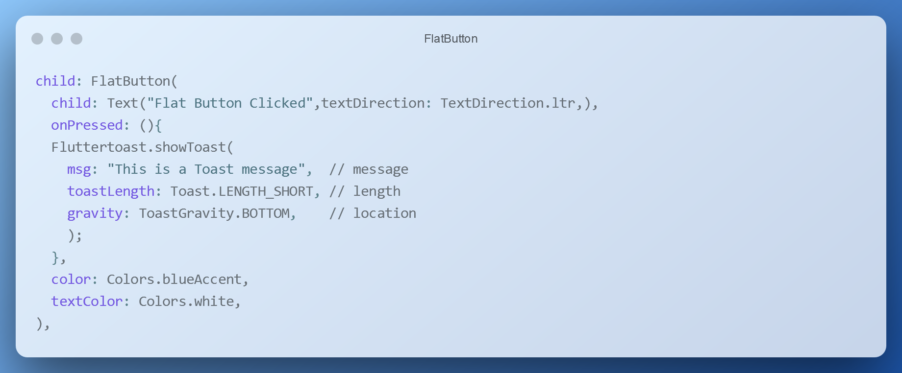
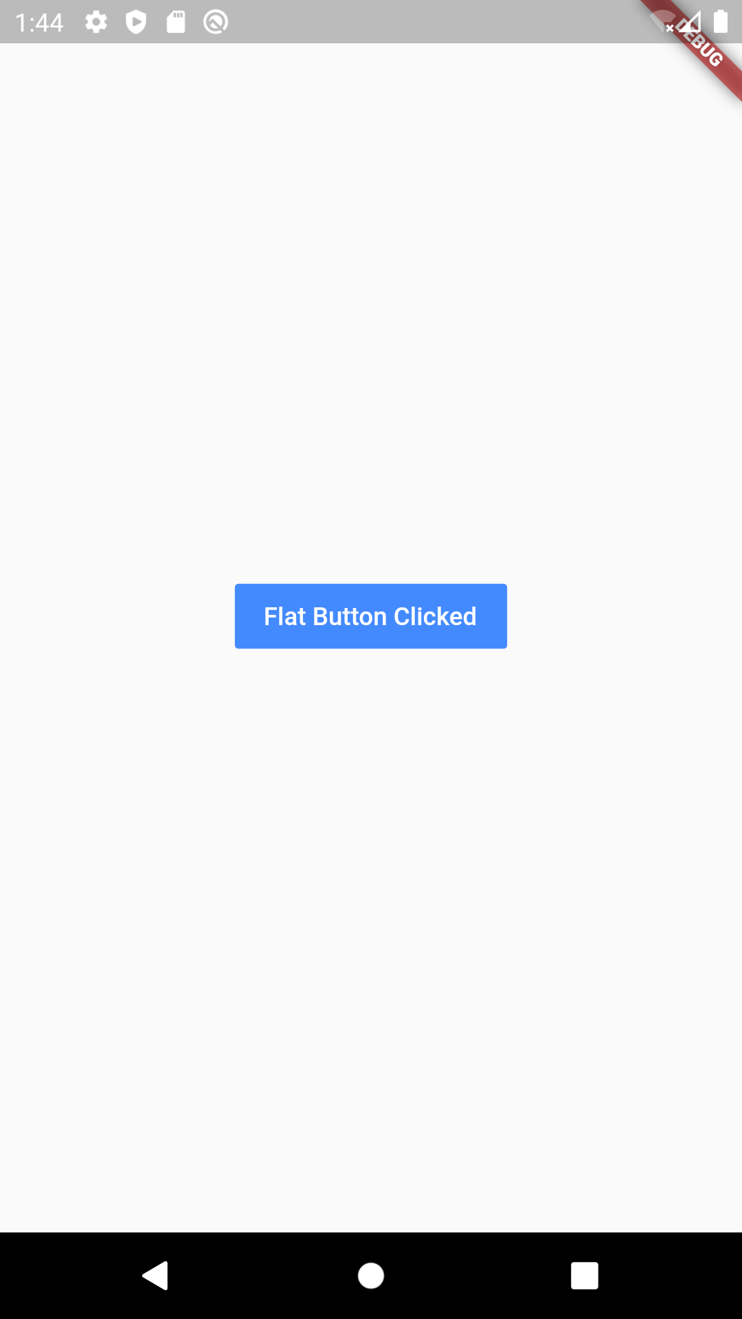

Slide 6
Raised Button
It’s also like the Flat button, but It has an elevation which is changing the size of the button on the z-axis when pressing it.
In Flat buttons, there has no elevation feature. Also, there have two callback functions(onPressed() and onLongPress()).
You can customize the attributes as in Flat buttons.

Slide 7
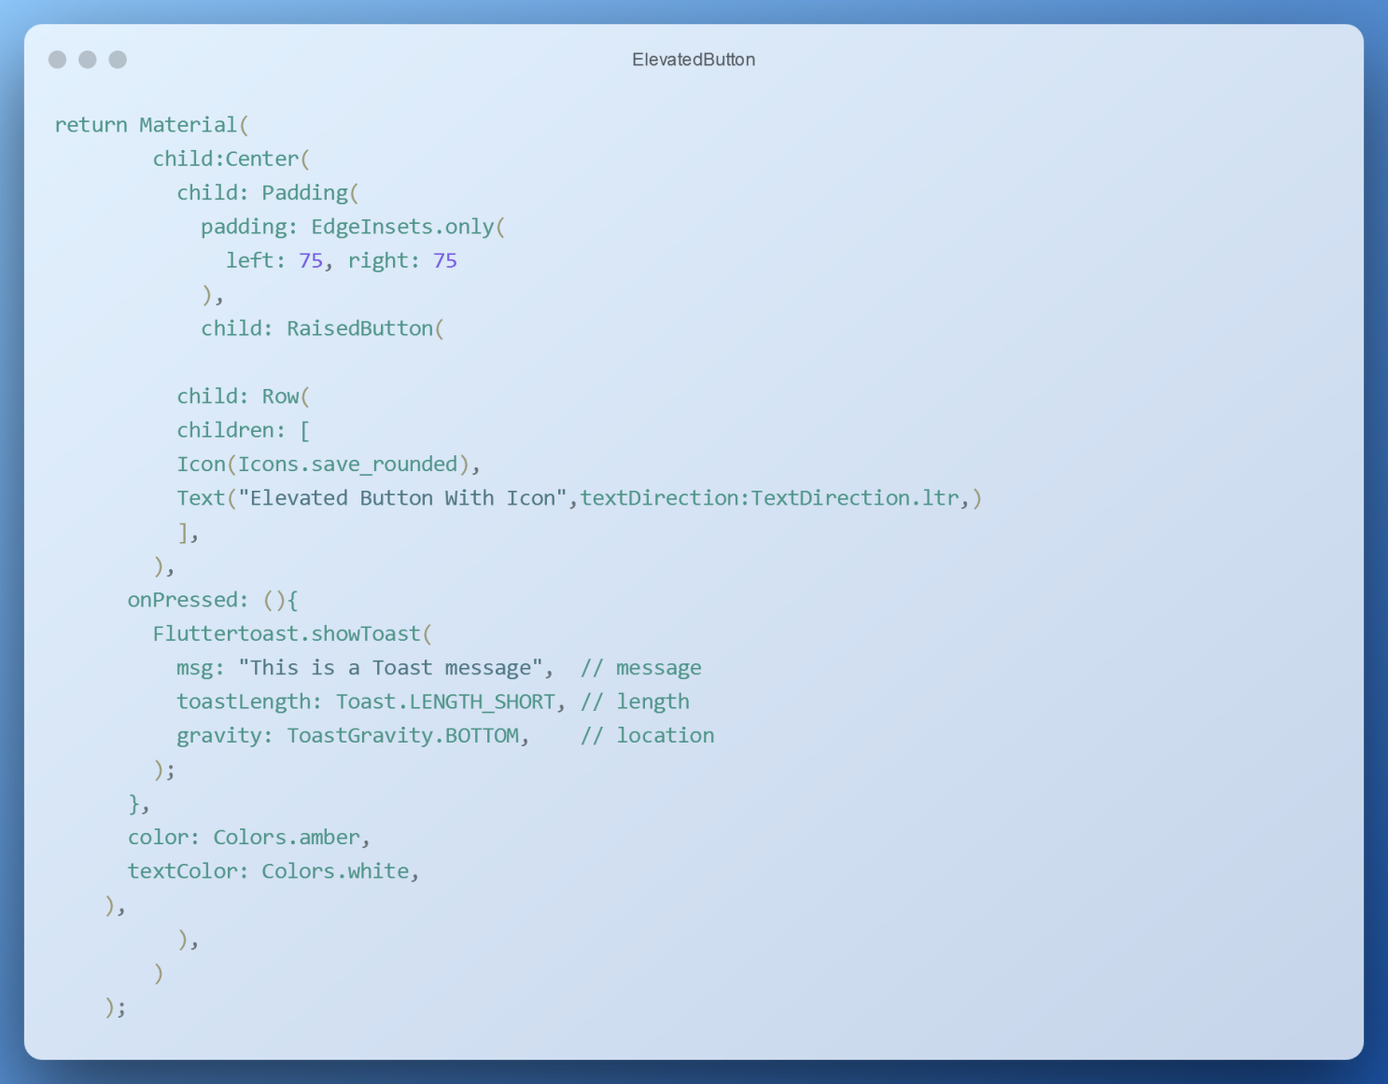
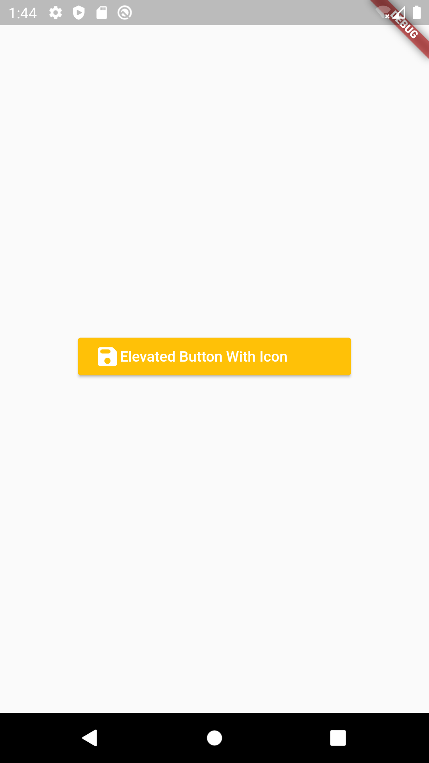

Slide 8
Floating Action Button
This is a special kind of button which contains under the Scaffold class.
This is placed and fixed at the right bottom corner of the screen. We can use it for sharing, refreshing, adding the content.
There are two types of Floating Action Buttons.
  With Text
  With Icon

Slide 9
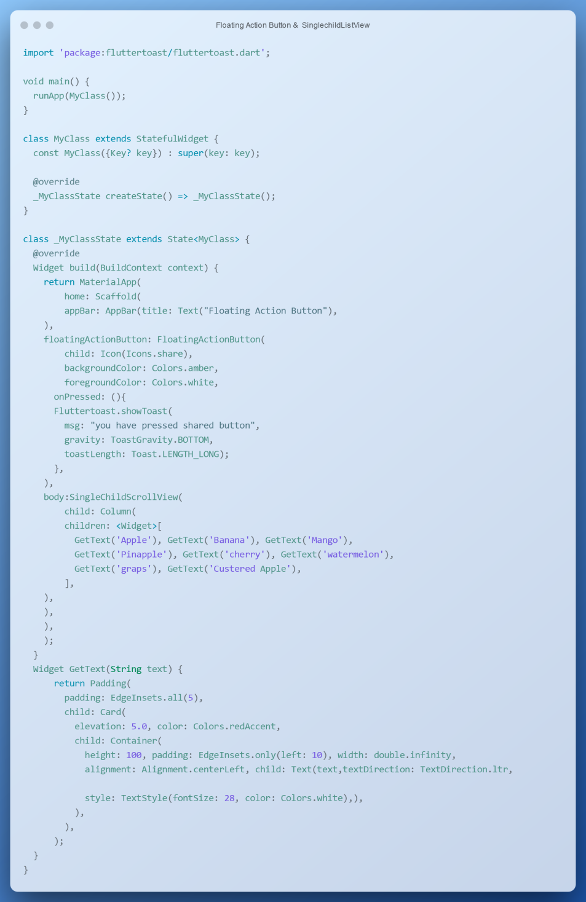
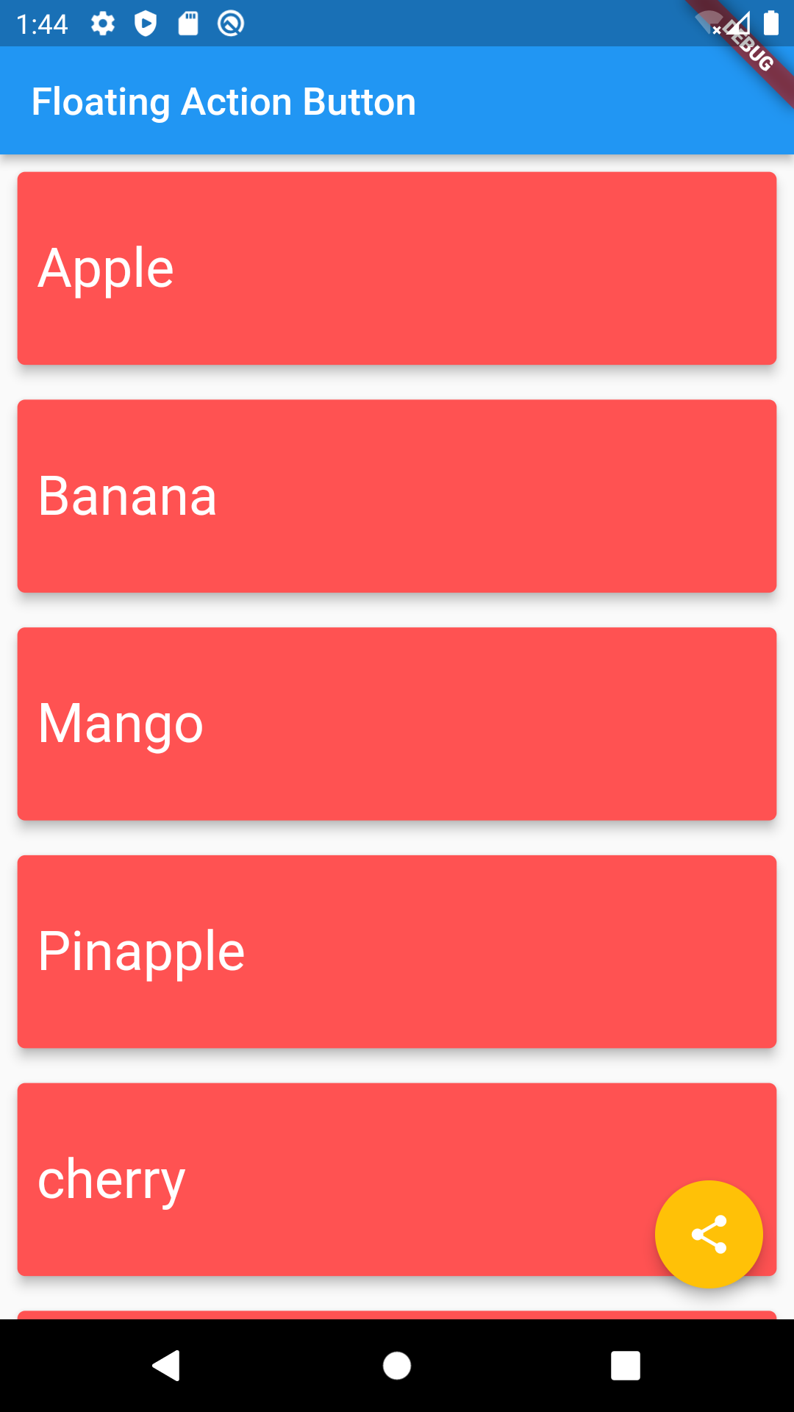

Slide 10
Icon Button
This is another type of button which is consisting of an icon than text.
When you touch on the icon it will respond according to its functionality.
Let us see example

Slide 11
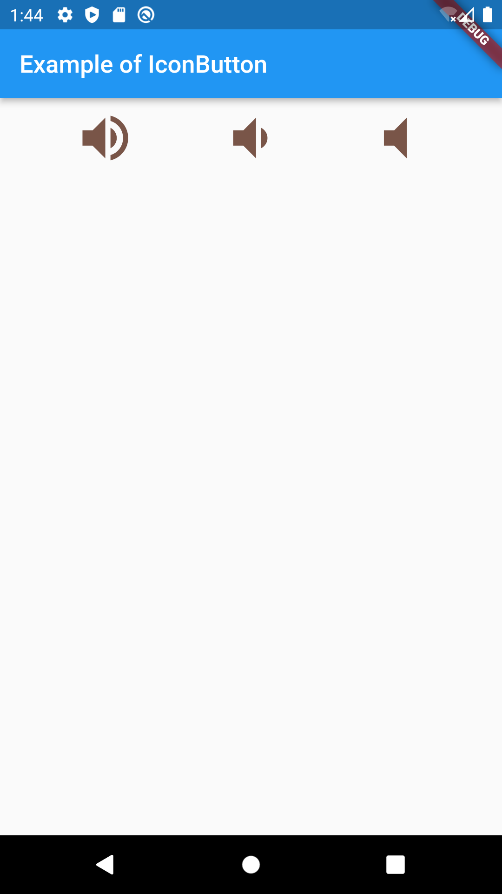
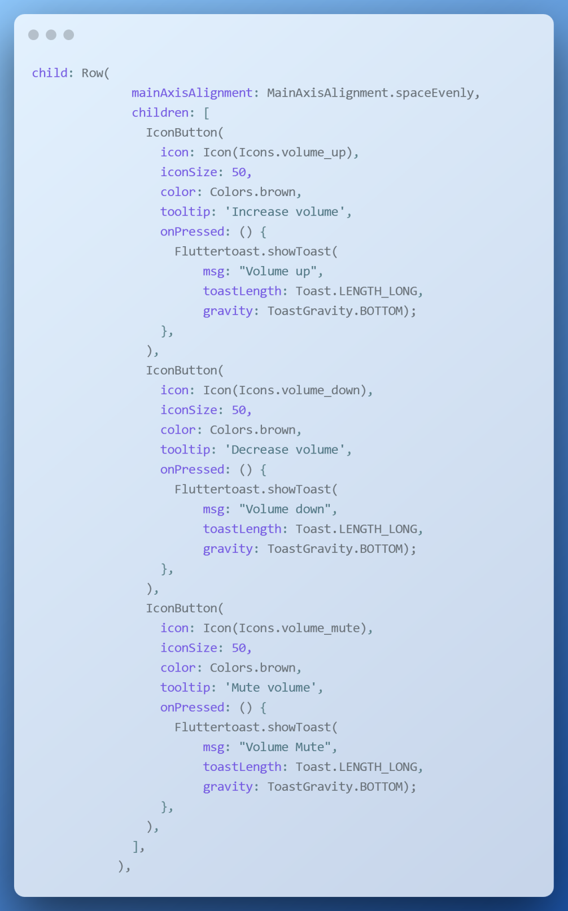

Slide 12
Popupmenu button
PopupMenuButton is used in AppBar to display some quick menu options.
In popmenu, when user select menitem, you can perform some action or navigate to other screen

Slide 13
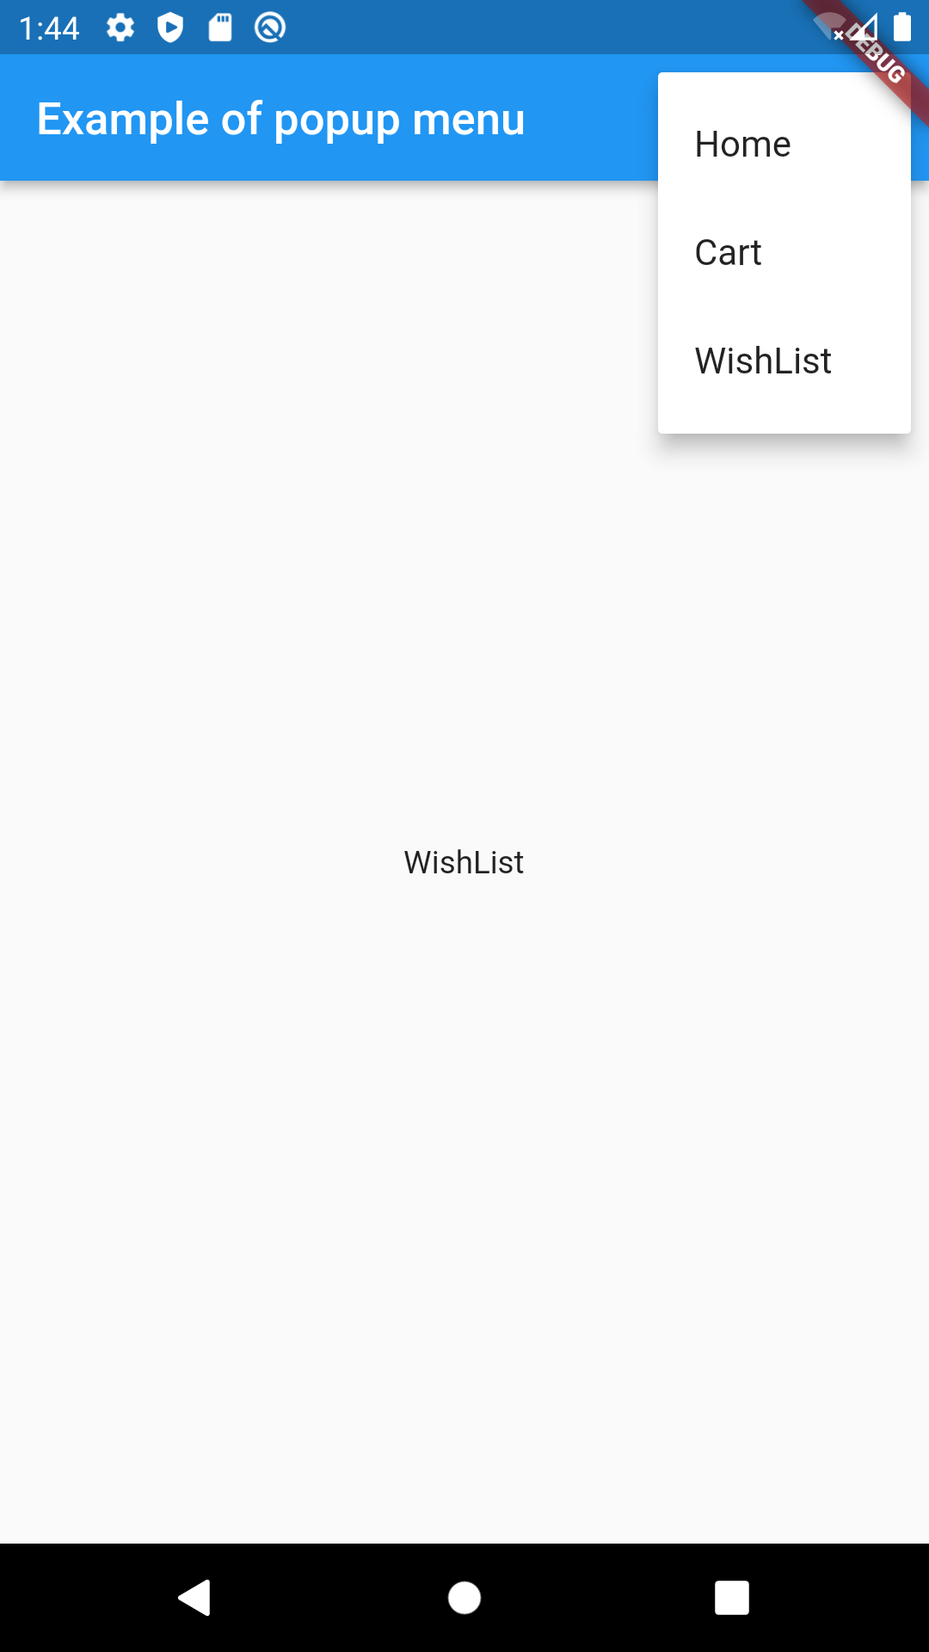
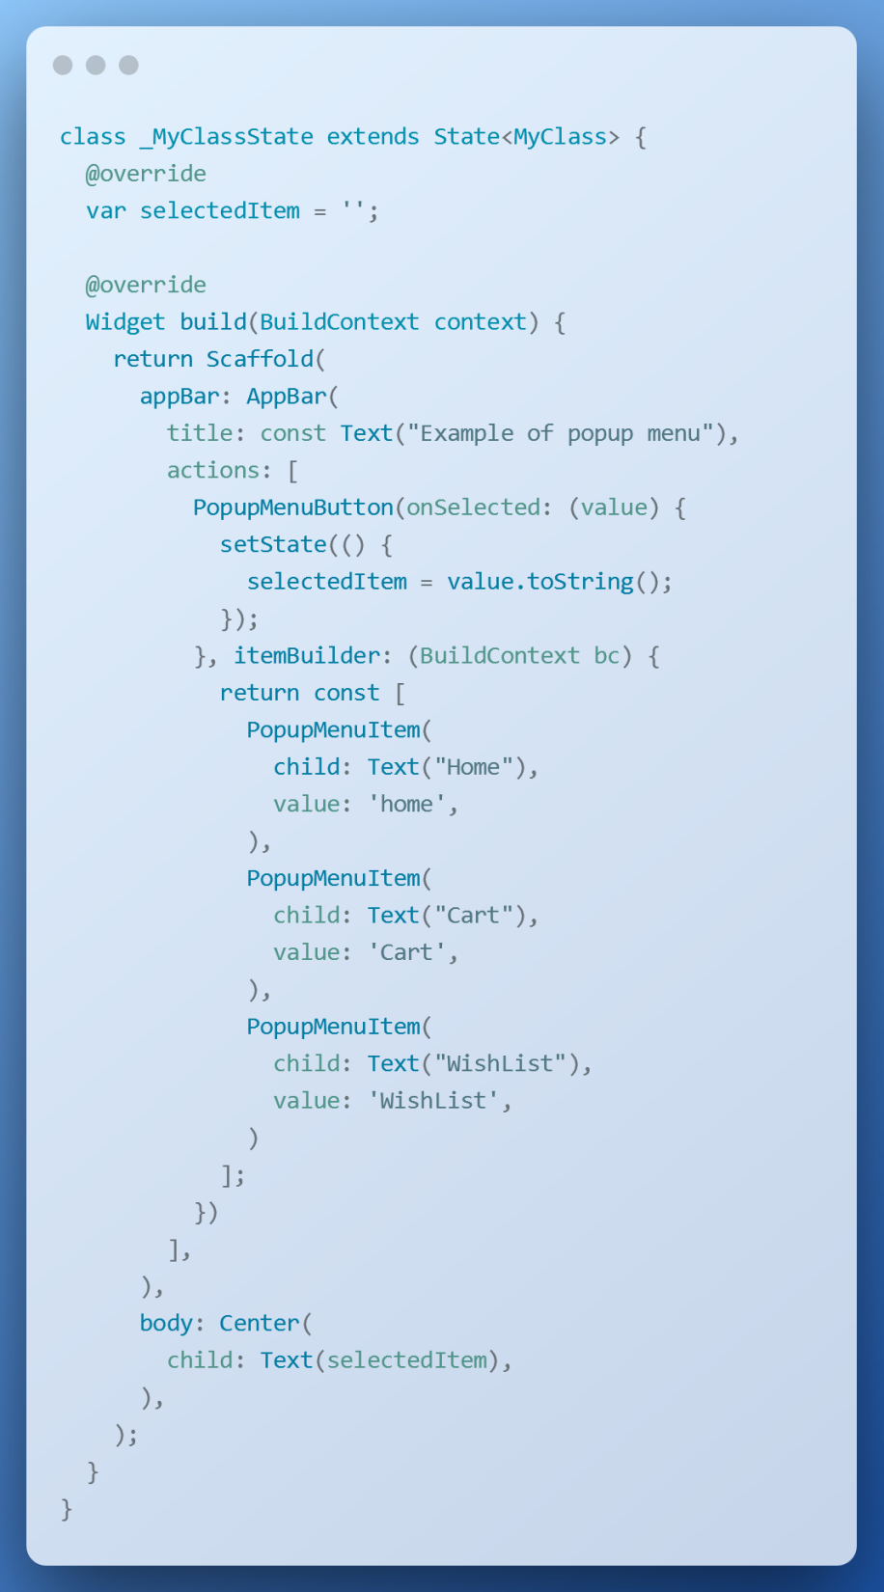

Slide 14
webview
The WebView allows you to display web pages as a part of your screen.
It display a web page without having to open your mobile device’s browser
It does not include any features of a fully developed web browser, such as navigation controls or an address bar.
WebView does, by default, is show a web page.
The WebView allows the programmer to write the bulk of the application using HTML, JavaScript and CSS, the standard Web programming tools.
Flutter WebViews are just like any other widget

Slide 15
How to use webview
Add following dependencies into flutter app.
webview_flutter: ^4.0.5
Import class
import 'package:webview_flutter/webview_flutter.dart';
Add webview in yout widget tree
The WebViewController is to set current URL being displayed.
Notes:
https://app-privacy-policy-generator.firebaseapp.com/

Slide 16
class TermsConditions extends StatefulWidget {
const TermsConditions({super.key});
@override
State<TermsConditions> createState() => _TermsConditionsState();
}
class _TermsConditionsState extends State<TermsConditions> {
late final WebViewController controller;
String URL = ‘www.google.com';
@override
void initState() {
super.initState();
controller = WebViewController()..loadRequest(Uri.parse(URL),);
}
@override
Widget build(BuildContext context) {
return WillPopScope(
onWillPop: () => _exitApp(context),
child: Scaffold(
appBar: AppBar(title: Text('Terms and condition'),),
body: WebViewWidget(controller: controller,),
),
);
}
Future<bool> _exitApp(BuildContext context) async {
if (await controller.canGoBack()==true) {
controller.goBack();
return Future.value(false);
}
else {
return Future.value(true);
}
}
}
`

Slide 17
Navigation and Routing
We know that every mobile application contains several screens for displaying different types of information.
Navigation and routing are core concepts of all mobile application, which allows the user to move between different screen.
For example, an app can have a screen that contains various products. When the user taps on that product, it will display detailed information about that product.
In Flutter, the screens are known as routes, and these routes are just a widget.
In Android, a route is called an Activity, whereas, in iOS, it is called ViewController.
In any mobile app, navigating to different pages create the workflow of the application, and the way to handle the navigation is known as routing.
Flutter provides a basic routing class MaterialPageRoute and two methods Navigator.push() and Navigator.pop() that shows how to navigate between two routes.

Slide 18
When we want to navigate to another screen, we use the push methods and Navigator widget adds the new screen onto the top of the stack.
When we want to move back we use pop methods, it remove that screen from the stack.
Let us see an example

Slide 19
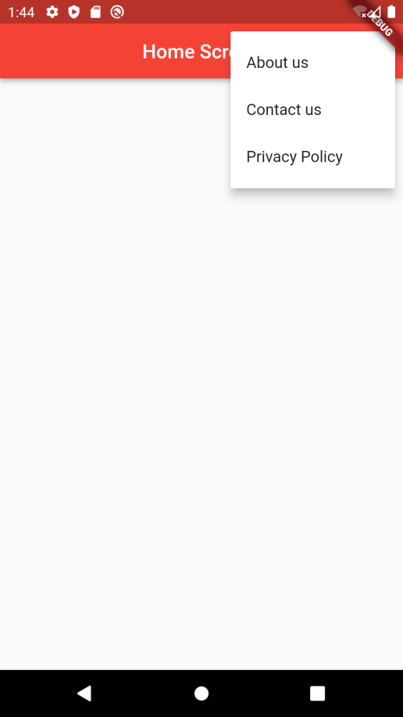
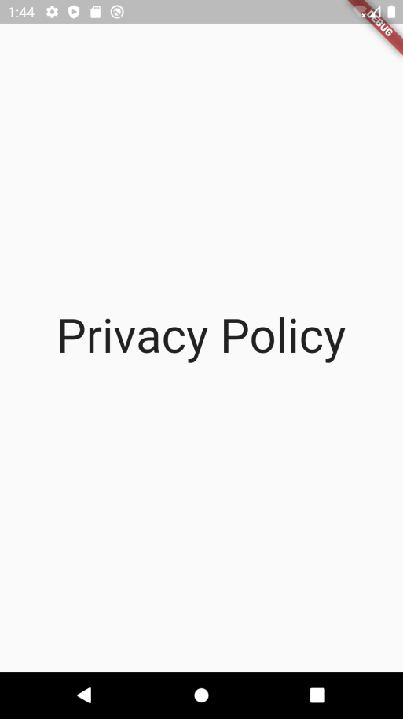
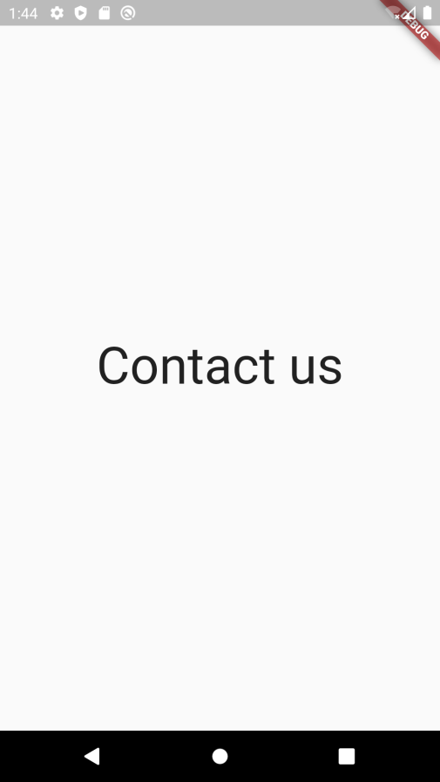
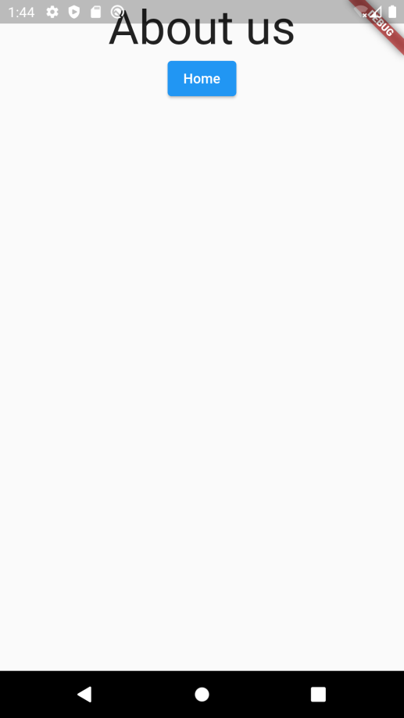

Slide 20
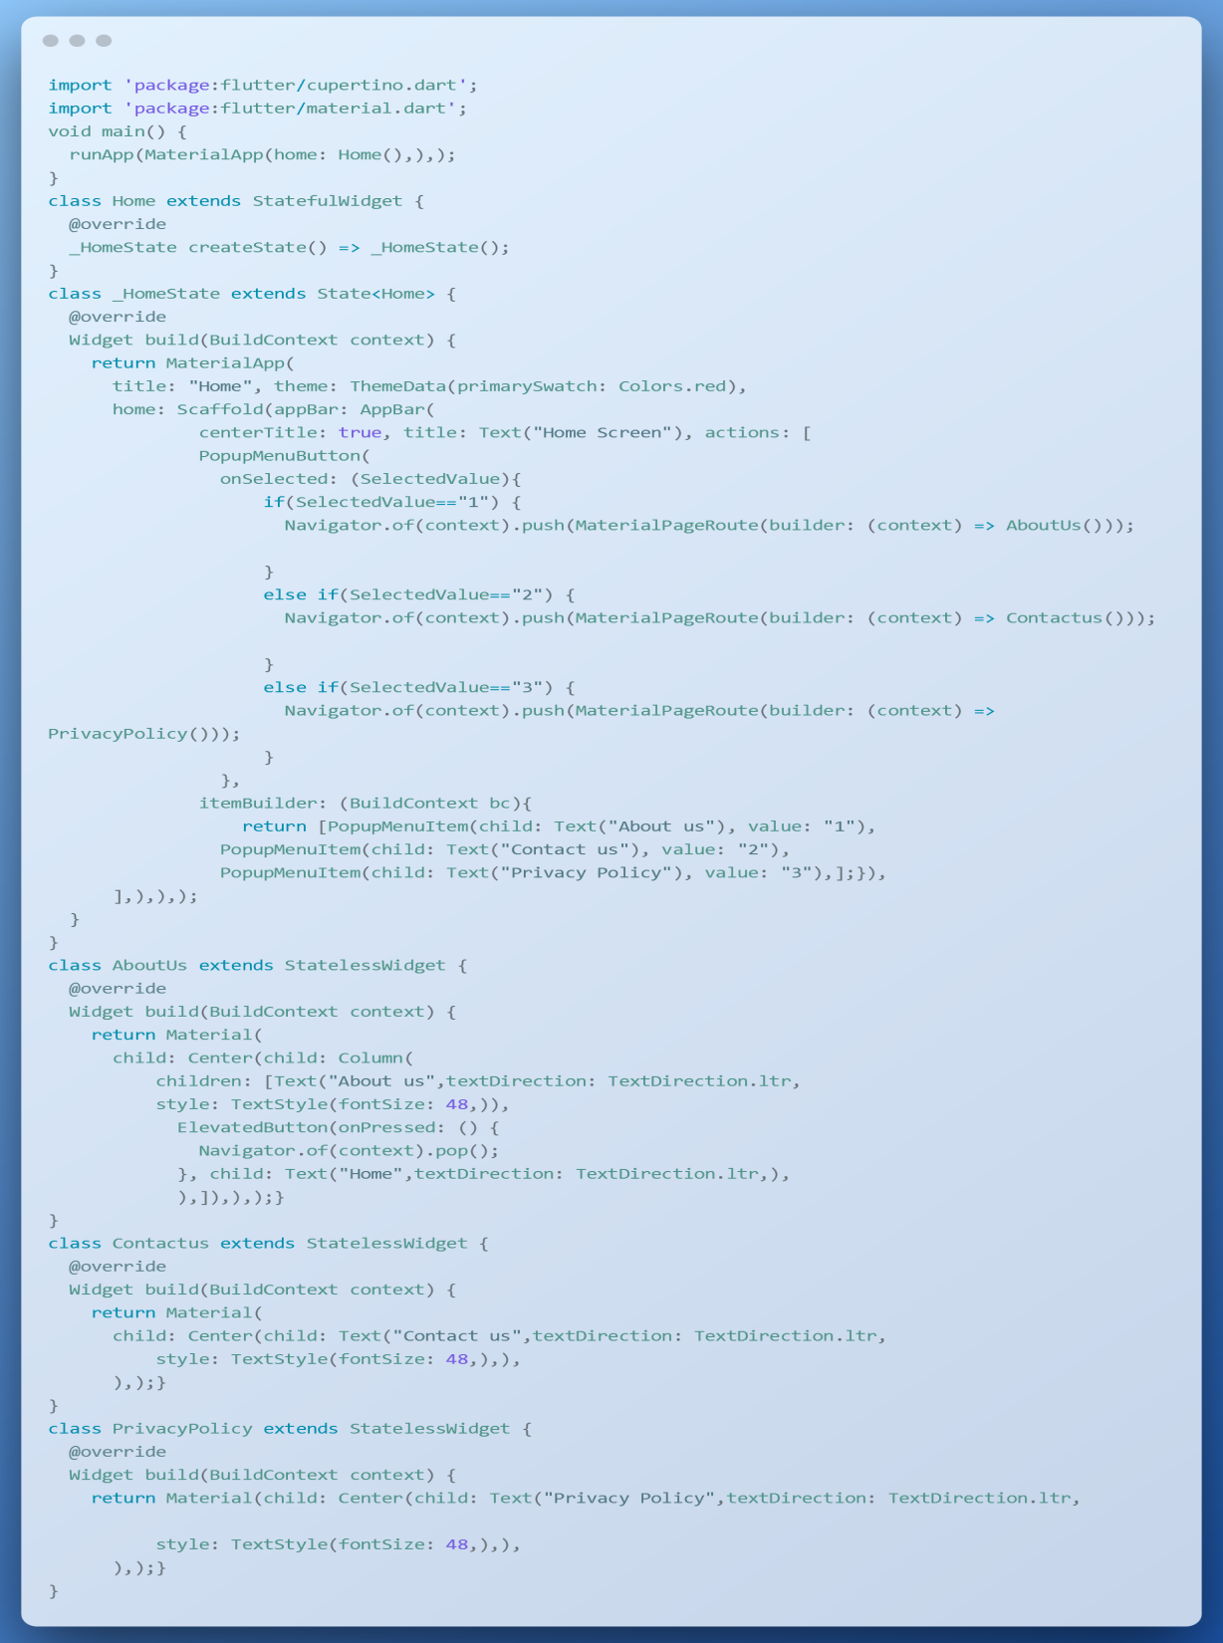

Slide 21
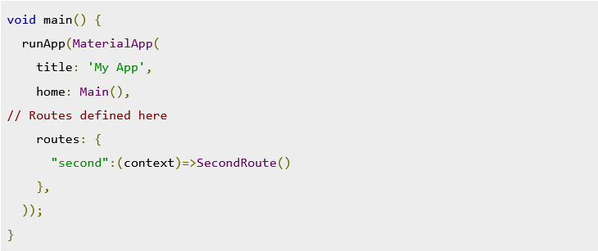
What is named routes
Named Routes is the simplest way to navigate to the different screens using naming concepts.
Instead of giving class name in routes we can give some meaningful and easy to use & easy remember names to class.
Such names given to class are called named which is also option navigate from one screen to another screen.
The route is a map with string keys and values such as builders that are passed to the routes property on MaterialApp:

Slide 22
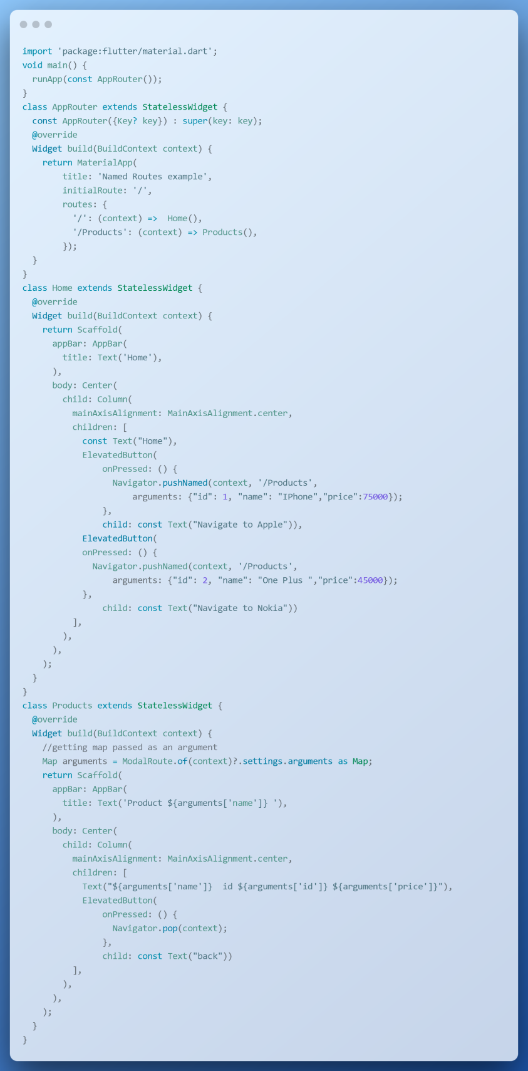
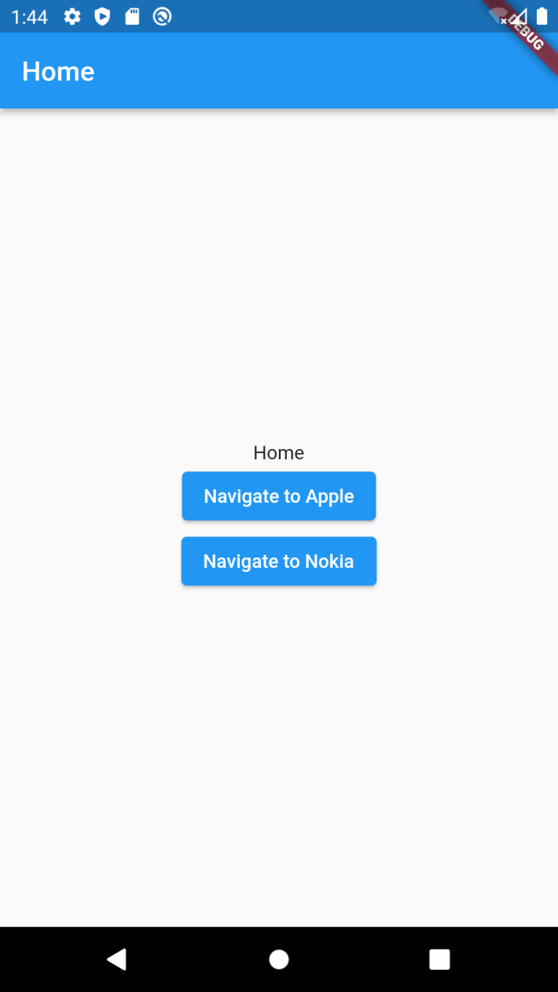

Slide 23
What is animation?
Animation is the process of making the illusion of motion and the illusion of change by means of the rapid display of a sequence of images that minimally differ from each other.
In mobile, Animations can add slight visual cues that notify users about what's going on in your app and improve their intellectual model of your app's interface.
Animations are especially useful when the screen changes state, such as when content loads or new actions become available.
Animations can also add a polished look to your app, which gives your app a higher quality feel.

Slide 24
Types of animation & way of doing it
Some common types of animation are
  Fade in
  Fade out
  Zoom in
  Zoom out
  Crosse fade
  Rotate
  Move
  Slide up
  Slide down
Animations between screen can be performed through either writing code or using plug-in in flutter code.
We will use plug-in named as
page_transition: "^2.0.5"

Slide 25
